Slide 1
Chapter 2: Operating-System Structures
Salam R. Al-E’mari
Adham University College – Girls Section

Slide 2
Outlines
Operating System Services
User Operating System Interface
System Calls
Types of System Calls
System Programs
Operating System Design and Implementation
Operating System Debugging
Operating System Generation
System Boot

Slide 3
Operating System Services
Operating systems provide an environment for execution of programs and services to programs and users.
One set of operating-system services provides functions that are helpful to the user:
  User interface - Almost all operating systems have a user interface (UI).
    Varies between Command-Line (CLI), Graphics User Interface (GUI), Batch
  Program execution - The system must be able to load a program into memory and to run that program, end execution, either normally or abnormally (indicating error)
  I/O operations - A running program may require I/O, which may involve a file or an I/O device

Slide 4
Operating System Services (Cont.)
One set of operating-system services provides functions that are helpful to the user (Cont.):
  File-system manipulation - The file system is of particular interest. Programs need to read and write files and directories, create and delete them, search them, list file Information, permission management.
  Communications – Processes may exchange information, on the same computer or between computers over a network
    Communications may be via shared memory or through message passing (packets moved by the OS)
  Error detection – OS needs to be constantly aware of possible errors
    May occur in the CPU and memory hardware, in I/O devices, in user program
    For each type of error, OS should take the appropriate action to ensure correct and consistent computing
    Debugging facilities can greatly enhance the user’s and programmer’s abilities to efficiently use the system

Slide 5
Operating System Services (Cont.)
Another set of OS functions exists for ensuring the efficient operation of the system itself via resource sharing
  Resource allocation - When multiple users or multiple jobs running concurrently, resources must be allocated to each of them
    Many types of resources - CPU cycles, main memory, file storage, I/O devices.
  Accounting - To keep track of which users use how much and what kinds of computer resources.
  Protection and security - The owners of information stored in a multiuser or networked computer system may want to control use of that information, concurrent processes should not interfere with each other
    Protection involves ensuring that all access to system resources is controlled
    Security of the system from outsiders requires user authentication, extends to defending external I/O devices from invalid access attempts

Slide 6
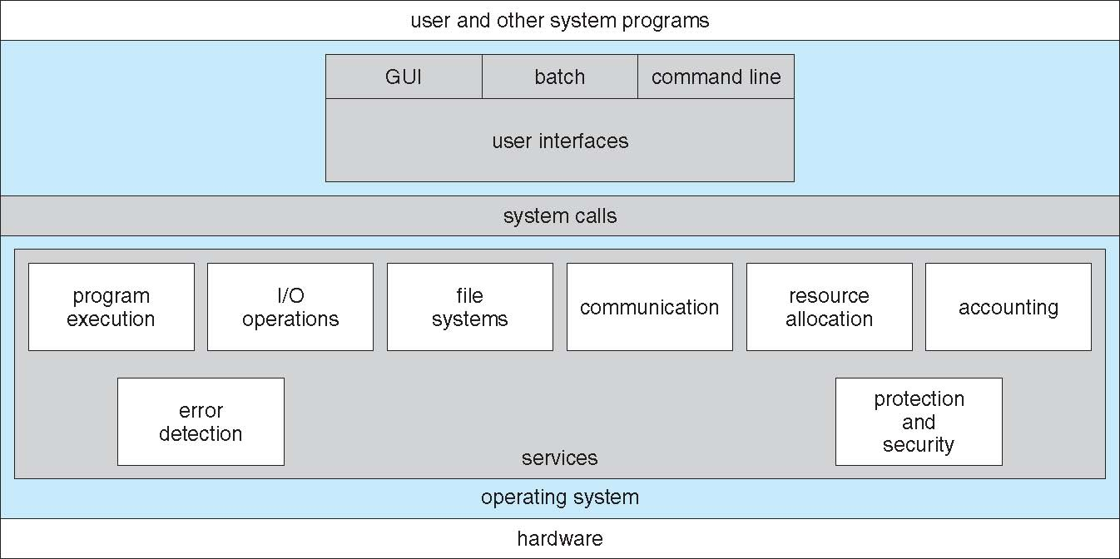
Operating System Services (Cont.)

Slide 7
System Calls
Programming interface to the services provided by the OS
Typically written in a high-level language (C or C++)
Mostly accessed by programs via a high-level Application Programming Interface (API) rather than direct system call use
Three most common APIs are Win32 API for Windows, POSIX API for POSIX-based systems (including virtually all versions of UNIX, Linux, and Mac OS X), and Java API for the Java virtual machine (JVM)
Note that the system-call names used throughout this text are generic

Slide 8
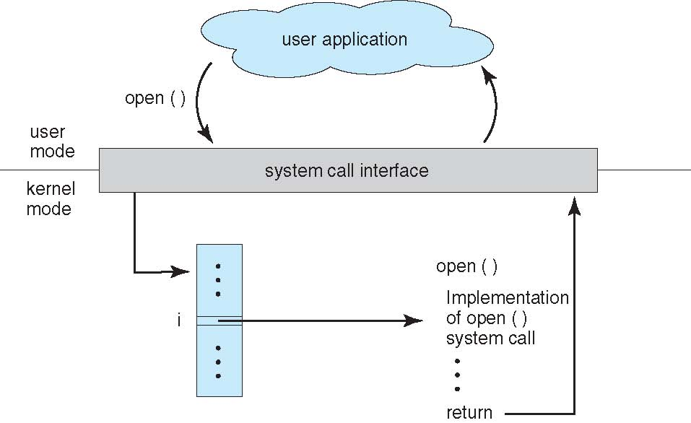
API – System Call – OS Relationship

Slide 9
System Call Parameter Passing
Often, more information is required than simply identity of desired system call
  Exact type and amount of information vary according to OS and call
Three general methods used to pass parameters to the OS
  Simplest: pass the parameters in registers
    In some cases, may be more parameters than registers
  Parameters stored in a block, or table, in memory, and address of block passed as a parameter in a register
    This approach taken by Linux and Solaris
  Parameters placed, or pushed, onto the stack by the program and popped off the stack by the operating system
  Block and stack methods do not limit the number or length of parameters being passed

Slide 10
Types of System Calls
Process control
File management
  create process, terminate process
  end, abort
  load, execute
  get process attributes, set process attributes
  wait for time
  wait event, signal event
  allocate and free memory
  Dump memory if error
  Debugger for determining bugs, single step execution
  Locks for managing access to shared data between processes
  create file, delete file
  open, close file
  read, write, reposition
  get and set file attributes
Device management
  request device, release device
  read, write, reposition
  get device attributes, set device attributes
  logically attach or detach devices

Slide 11
Types of System Calls (Cont.)
Communications
Information maintenance
  create, delete communication connection
  send, receive messages if message passing model to host name or process name
    From client to server
  Shared-memory model create and gain access to memory regions
  transfer status information
  attach and detach remote devices
  get time or date, set time or date
  get system data, set system data
  get and set process, file, or device attributes
Protection
  Control access to resources
  Get and set permissions
  Allow and deny user access

Slide 12
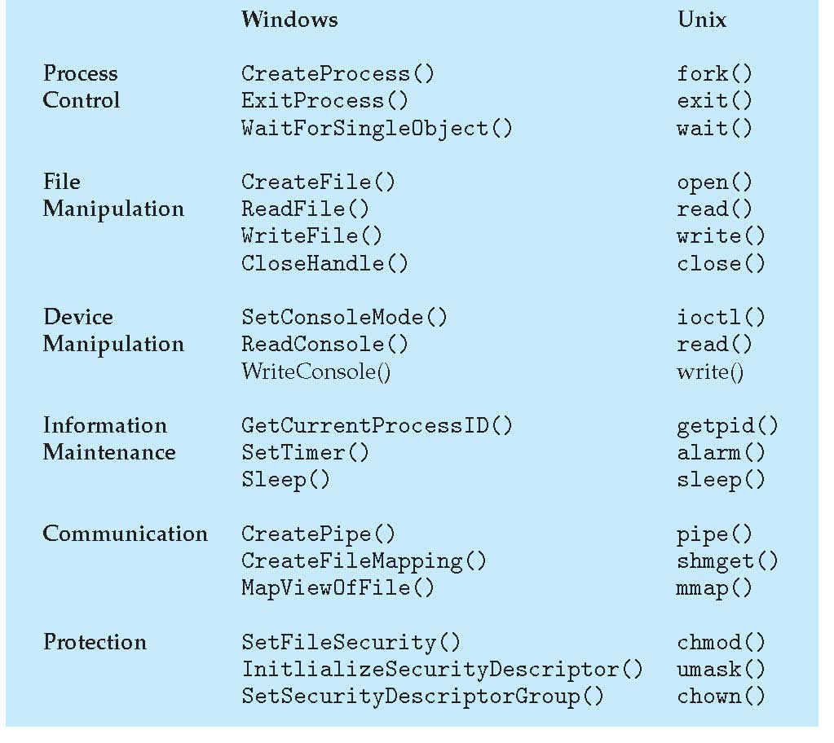
Examples of Windows and Unix System Calls

Slide 13
System Programs
System programs provide a convenient environment for program development and execution. They can be divided into:
  File manipulation
  Status information sometimes stored in a File modification
  Programming language support
  Program loading and execution
  Communications
  Background services
  Application programs
Most users’ view of the operation system is defined by system programs, not the actual system calls

Slide 14
System Programs (Cont.)
Provide a convenient environment for program development and execution
  Some of them are simply user interfaces to system calls; others are considerably more complex
File management - Create, delete, copy, rename, print, dump, list, and generally manipulate files and directories
Status information
  Some ask the system for info - date, time, amount of available memory, disk space, number of users
  Others provide detailed performance, logging, and debugging information
  Typically, these programs format and print the output to the terminal or other output devices
  Some systems implement a registry - used to store and retrieve configuration information

Slide 15
System Programs (Cont.)
File modification
  Text editors to create and modify files
  Special commands to search contents of files or perform transformations of the text
Programming-language support - Compilers, assemblers, debuggers and interpreters sometimes provided.
Program loading and execution- Absolute loaders, relocatable loaders, linkage editors, and overlay-loaders, debugging systems for higher-level and machine language.
Communications - Provide the mechanism for creating virtual connections among processes, users, and computer systems
  Allow users to send messages to one another’s screens, browse web pages, send electronic-mail messages, log in remotely, transfer files from one machine to another

Slide 16
System Programs (Cont.)
Background Services
  Launch at boot time
    Some for system startup, then terminate
    Some from system boot to shutdown
  Provide facilities like disk checking, process scheduling, error logging, printing
  Run in user context not kernel context
  Known as services, subsystems, daemons
Application programs
  Don’t pertain to system
  Run by users
  Not typically considered part of OS
  Launched by command line, mouse click, finger poke

Slide 17
Operating System Design and Implementation
Design and Implementation of OS not “solvable”, but some approaches have proven successful
Internal structure of different Operating Systems can vary widely
Start the design by defining goals and specifications
Affected by choice of hardware, type of system
User goals and System goals
  User goals – operating system should be convenient to use, easy to learn, reliable, safe, and fast
  System goals – operating system should be easy to design, implement, and maintain, as well as flexible, reliable, error-free, and efficient

Slide 18
Operating System Design and Implementation (Cont.)
Important principle to separate
Policy: What will be done?
Mechanism: How to do it?
Mechanisms determine how to do something, policies decide what will be done
The separation of policy from mechanism is a very important principle, it allows maximum flexibility if policy decisions are to be changed later (example – timer)
Specifying and designing an OS is highly creative task of software engineering

Slide 19
iOS
Apple mobile OS for iPhone, iPad
  Structured on Mac OS X, added functionality
  Does not run OS X applications natively
    Also runs on different CPU architecture (ARM vs. Intel)
  Cocoa Touch Objective-C API for developing apps
  Media services layer for graphics, audio, video
  Core services provides cloud computing, databases
  Core operating system, based on Mac OS X kernel

Slide 20
Android
Developed by Open Handset Alliance (mostly Google)
  Open Source
Similar stack to IOS
Based on Linux kernel but modified
  Provides process, memory, device-driver management
  Adds power management
Runtime environment includes core set of libraries and Dalvik virtual machine
  Apps developed in Java plus Android API
    Java class files compiled to Java bytecode then translated to executable than runs in Dalvik VM
Libraries include frameworks for web browser (webkit), database (SQLite), multimedia, smaller libc

Slide 21
System Boot
When power initialized on system, execution starts at a fixed memory location
  Firmware ROM used to hold initial boot code
Operating system must be made available to hardware so hardware can start it
  Small piece of code – bootstrap loader, stored in ROM or EEPROM locates the kernel, loads it into memory, and starts it
  Sometimes two-step process where boot block at fixed location loaded by ROM code, which loads bootstrap loader from disk
Common bootstrap loader, GRUB, allows selection of kernel from multiple disks, versions, kernel options
Kernel loads and system is then running

Slide 22
Thank You ☺

