Slide 1


Slide 2
Introduction
to
Medical Parasitology

Slide 3
Schedule
1st semester:
Introduction to Medical Parasitology (4 lectures).
2nd semester:
Organ-Based Parasitic Infections (26 lectures).
60 min / Lecture
You can not miss > 25% of classes.

Slide 4
Medical Parasitology
Medical Parasitology: that branch of medical sciences that deals with parasites that cause or transmit disease to man.
Parasites: organisms that live in or on a host (temporarily or permanently) deriving food and shelter and causing harm to that host.
Parasite and Parasitism are terms that define a way of life.

Slide 5
Parasitism - a way of life
Symbiosis: “Any two organisms living in close association, commonly one living in or on the body of the other, are symbiotic, as contrasted with free living.”
Symbiosis may be:
Commensalism: Sharing the table. One partner benefits but the other is not hurt.
Mutualism: Both partners benefit.
Parasitism: One partner (the parasite) harms or lives on the expense of the other (host).

Slide 6
Parasitism
Facultative parasitism: When an organism can live free or establishes a parasitic existence depending on a host.
Obligatory parasitism: When an organism establishes a permanent parasitic existence and is completely dependent on the host.
Accidental or incidental parasitism: occasionally an organism parasitizes a species other than its usual host.

Slide 7
Types of Parasites
Endoparasites: live within the host causing infection.
Ectoparasites: live on the external surface of the host causing infestation.
Temporary parasite: only visits the host to get its meal.
Permanent parasite: always fixed to the host.
Opportunistic parasite: produces disease only in immunodeficient hosts.
Facultative parasites: ?
Obligate parasites: ?
Accidental parasites: ?

Slide 8
Types of Hosts
Definitive host: in which the adult or sexually reproducing form of the parasite lives.
Intermediate host: in which the parasite lives during its larval stage or asexually reproducing form.
Reservoir host: an animal harboring the same stage of the parasite like in human. Reservoir hosts represent a potential source of infection to man.
Vector “usually an arthropod”: transmits parasites (or other pathogens) from infected organisms to other hosts.

Slide 9
Habitat
The habitat is where the parasite lives and multiplies in the body of the definitive or intermediate host, like:
Small intestine
Large intestine
Blood vessels
Organs; liver, lung, heart, brain, …..
Muscles
Lymphatics
Reticuloendothelial system
Cells as red blood cells

Slide 10
Sources of parasitic infections
Water
Soil
Raw vegetables & fruits
Animals
Fish
Vector [Arthropods]
Blood

Slide 11
Modes of infection
Ingestion
Inhalation
Penetration of skin & mucous membrane
Bite of vector
Direct contact
Congenital transmission
Blood transfusion
Sexual
Trans-mamary

Slide 12
Pathogenisis: Dangerous effects of parasitic infection
1- Parasitic toxic products: produce allergy or necrosis.
2- Anaemia: Malarial parasite & Ancylostoma.
3- Loss of weight.
4- Fever & eosinophilia.
5- Mechanical obstruction: Ascaris.
6- Mechanical pressure: Hydatid cyst.
8- Abortion or Congenital anomalies: T. gondii.

Slide 13
Taxonomic classification of parasites
Taxonomic classification groups together animals of similar structure, function and behavior into distinct groupings [Kingdom, Phyla, Classes, Orders, Families, Genera & classes].
Parasitic organisms of medical importance are eukaryotes.
Parasites of medical importance are classified into 2 sub-kingdoms:
PROTOZOA (unicellular) & METAZOA (multicellular)
. Protozoan parasites are classified according to morphology & means of locomotion.
Metazoan parasites include: . Helminths (worms).
. Arthropods (posses an external skeleton).

Slide 14
Scientific Nomenclature
Binomial System of Nomenclature:
Each parasite belongs to: Phylum, Class, Order, Family, Genus and Species.
Each parasite is written by Generic name (with 1st letter capital) and Specific name (1st letter small); and printed in italics or underlined.
Example: Schistosoma mansoni
or Schistosoma mansoni

Slide 15
Medical Parasitology includes the study of 3 major groups of parasites:
Protozoa
Arthropods
Helminths
Hi I am a protozoa called One-celled organisms
I like to present my self as insects and my allies
Simply called Worms
e.g. Glossina morsitans
e.g. Giardia lamblia
e.g. Ascaris lumbricoides

Slide 16
Scheme of Study
Name of parasitic disease & causative parasite:
e.g.: Disease name: Fascioliasis
Parasite name: Fasciola hepatica
Geographical Distribution.
Life cycle
Morphology (Adult, larva, …) >> Lab.
Pathogenesis & clinical picture
Diagnosis (clinical & Lab.)
Treatment
Prevention & Control

Slide 17
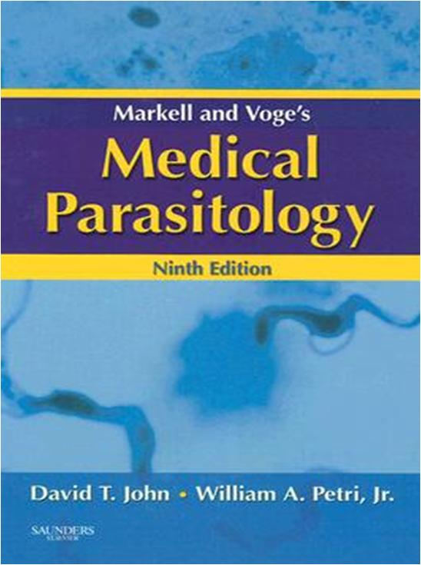
Suggested Text Book

Slide 18
Websites of Interest
There are thousands of reading resources on internet providing information and images on parasites, not all of them are as trustworthy.
Two excellent sites to look for general information and visual illustrations:
CDC (Division of Parasitic Diseases)
WHO (Tropical Diseases Research Program)
Notes:
Trustworthy = جدير بالثقة

