Slide 2
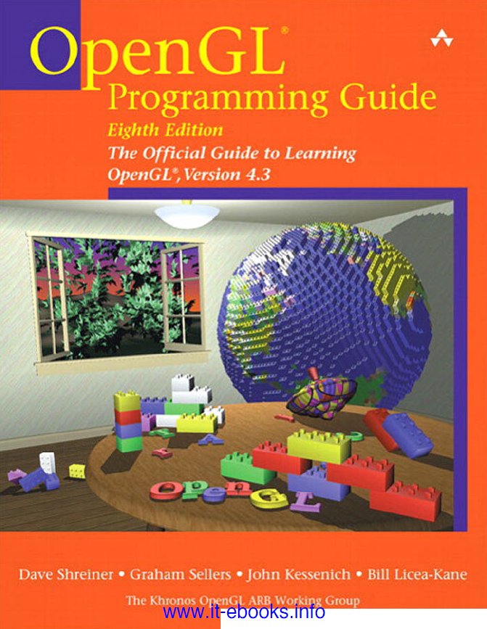
References
Lab Lectures, Computer Graphics, Taif University, Faculty Of Computers And Information Technology, TA. Maha Thafar &TA. Haifa Alshehri, TA.Sohair Soliman & L.Shakila Bano.
OpenGL Programming Guide: The Official Guide to Learning OpenGL, Versions 4.3, 8th edition, Dave Shreiner, Graham Sellers, John Kessenich, Bill Licea-Kane & The Khronos OpenGL ARB Working Group, Addison-Wesley.
https://dottheslash.wordpress.com/2009/12/07/setting-up-codeblocks-with-glut-for-windows/

Slide 3
Lecture One
Introduction

Slide 4
Content
What is Computer Graphic?
Computer Graphics Application.
Coordinate System.
Color System.
RGB Color Space (Color Cube).
Important Expressions.
Graphics Library (GL).
Setting-up the Environment.

Slide 5
What is Computer Graphics?
Computer Graphics:
It is the creation and manipulation of images by the computer.
branch of computer science that deals with the theory and techniques of computer image synthesis. Computers produce images by analyzing a collection of dots( pixels).

Slide 6
Computer Graphics Applications
CAD(Computer Aided Design).
Presentation Graphics.
Flight Simulator System.
Training.
Scientific Visualization (Medical Visualization).
Entertainment: Games …..etc.

Slide 7
Coordinate System
In 2-D graphics, each point is given a position 2-D position that has x, y coordinates, and in the same way the 3-D graphics, each point is given a position 3-D position that has x, y and z coordinates.
The origin has coordinates (0,0,0) and is set arbitrarily as the reference point.
Y
5
6
X
Z
This point has coordinates (6,0,5).

Slide 8
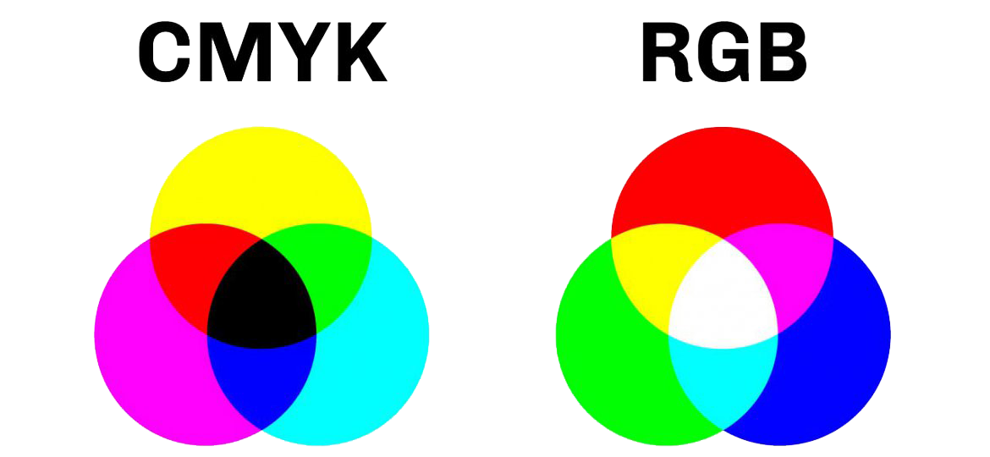
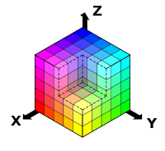
Color Systems
Color Gamut is the total range of colors reproduced by a color model or a device.
Types of Color Models:
CIE system (Represented as a 2-d graphic).
RGB model.
CMY model.
CMYK model .. etc.
Blue
Red
Green

Slide 9
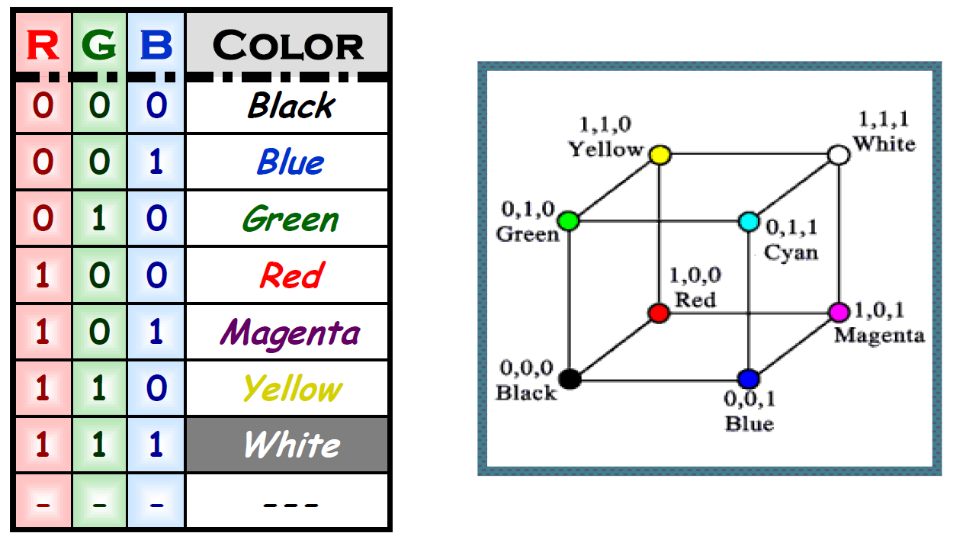
RGB Color Space (Color Cube)
Color in RGB format is a triplet of numbers. The three components are Red, Green and Blue.
It uses red, green and blue (r, g, b) light to mix and define color.
We can determine the color by value: zero and one.
If 0 is the minimum and 1 is the maximum value, then (1,1,1) is white and the others colors as the following table:

Slide 10
Important Expressions
Bit: binary digit.
Pixel: picture element.
Image: array of pixels.
Resolution: density of pixels (number of pixels in unit area).
Note: Two-dimensional graphics is a special case of three-dimensional graphics.

Slide 11
Graphics Library (GL)
GL : is a short form of Graphics Library.
or as other references :(Graphics Language)
To access the system, application programmers used a library called GL.
With GL, it was relatively simple to program three dimensional interactive applications.
The success of GL lead to OpenGL.

Slide 12
Setting-Up the Environment
Program Used:
Code::Blocks (As a C++ compiler), you can use any other c++ complier.
Downloading and Installing of the Program:
From Code::Blocks Site: http://www.codeblocks.org/downloads/26

Slide 13
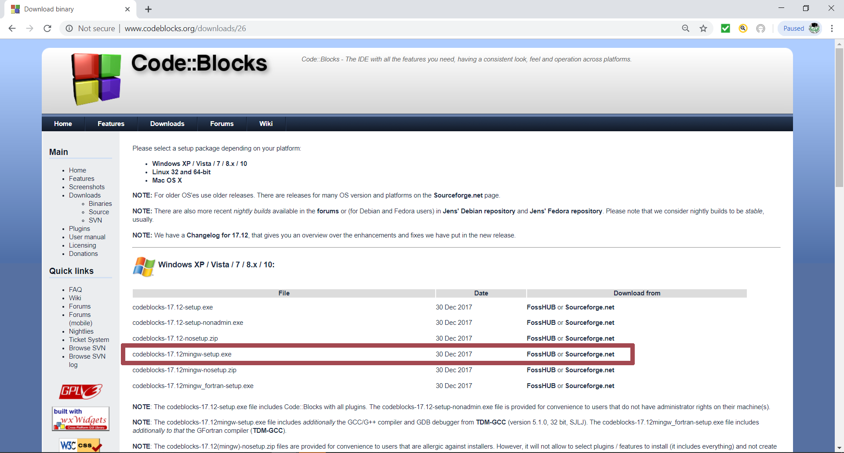
Setting-Up the Environment

Slide 14
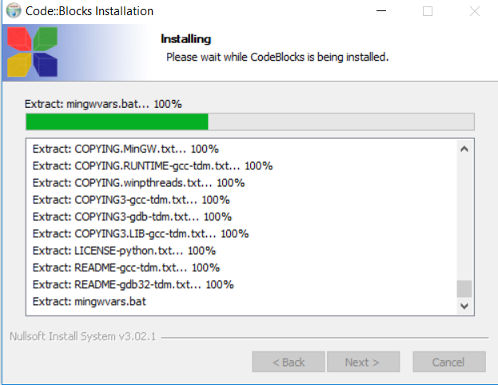
Setting-Up the Environment

Slide 15
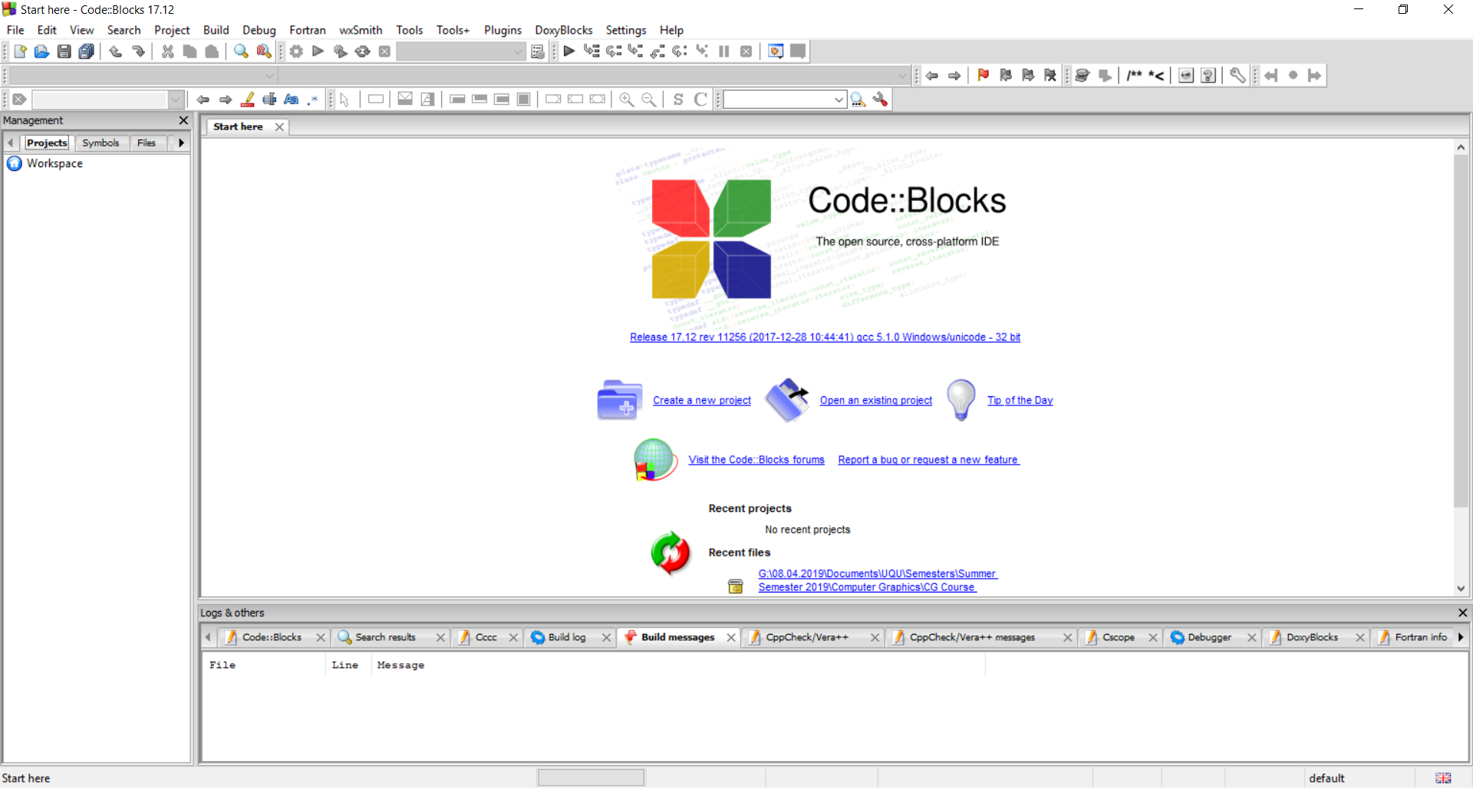
Setting-Up the Environment

Slide 16
Setting-Up the Environment
Downloading and Installing OpenGL Library:
From https://user.xmission.com/~nate/glut.html or https://www.opengl.org/resources/libraries/glut/

Slide 17
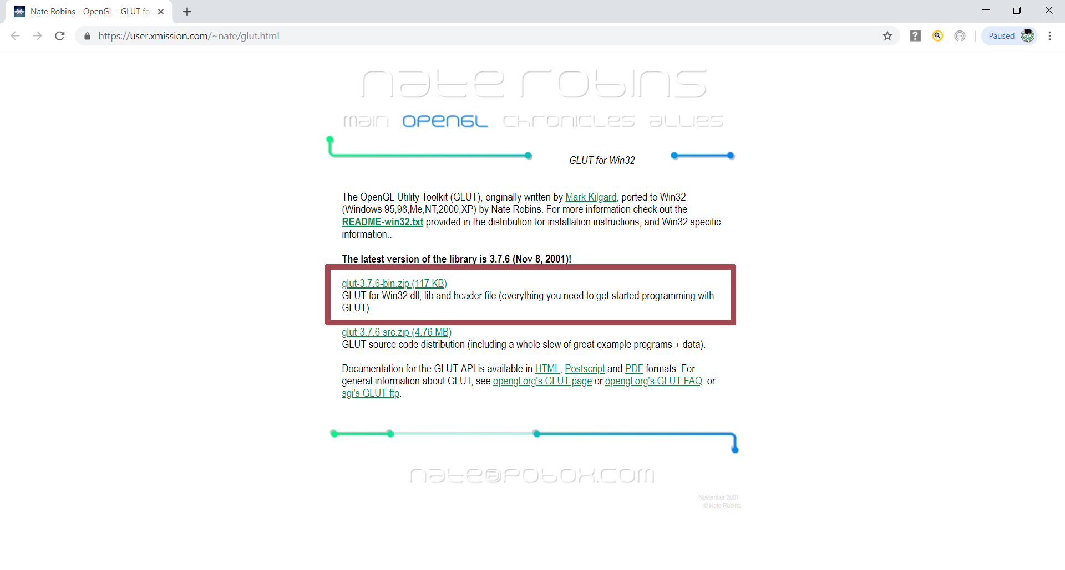
Setting-Up the Environment

Slide 18
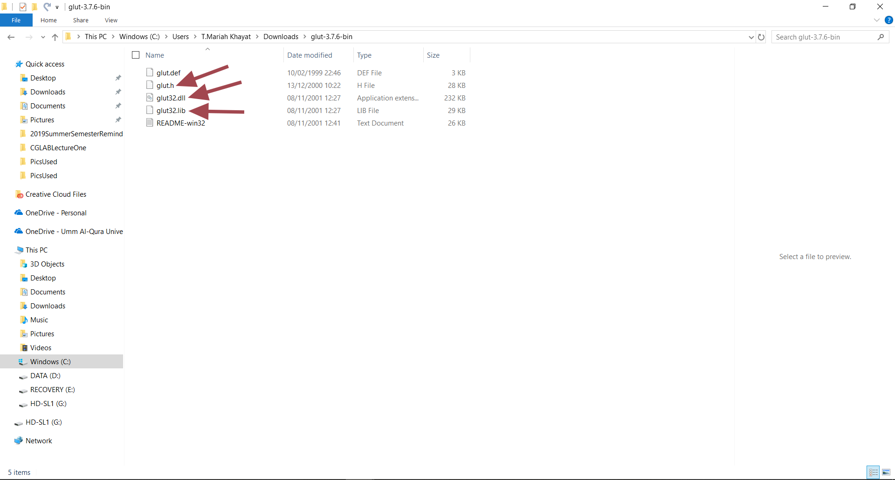
Setting-Up the Environment

Slide 19
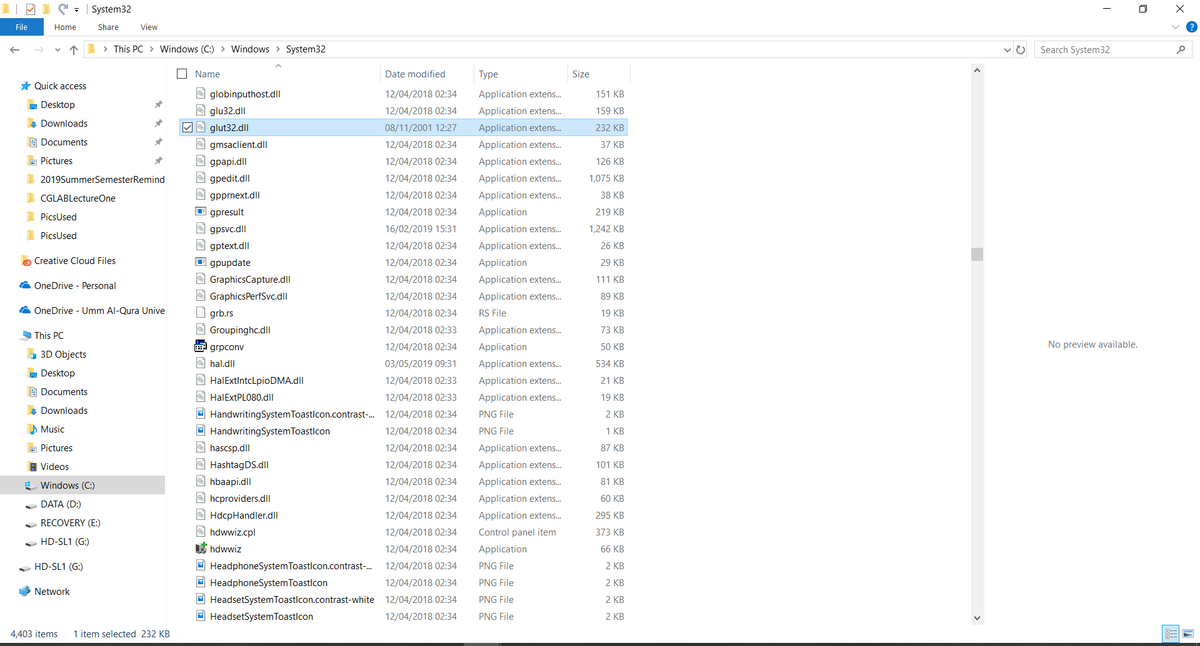
Setting-Up the Environment
Move the glut32.dll file to your \windows\system directory.

Slide 20
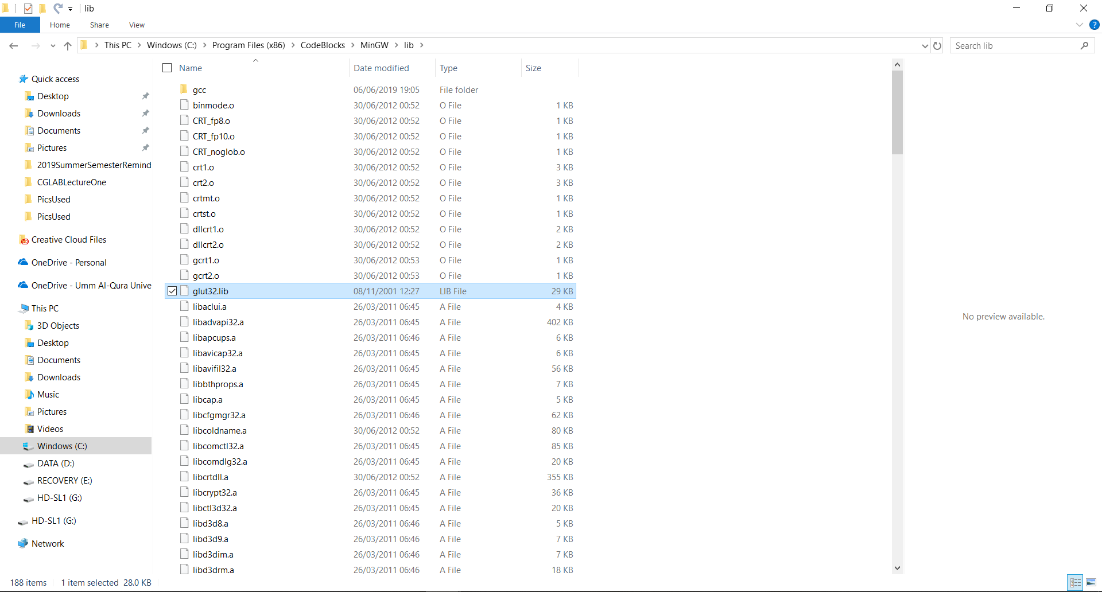
Setting-Up the Environment
Move the glut32.lib file to the \CodeBlocks\MinGW\lib directory.

Slide 21
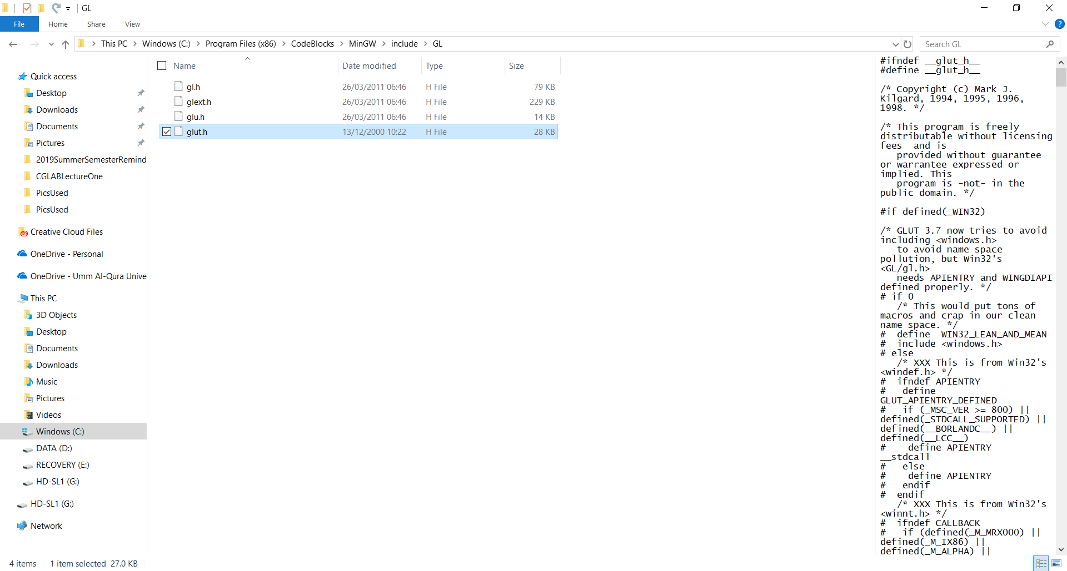
Setting-Up the Environment
Move the glut.h file to the \CodeBlocks\MinGW\include\GL directory.

Slide 22
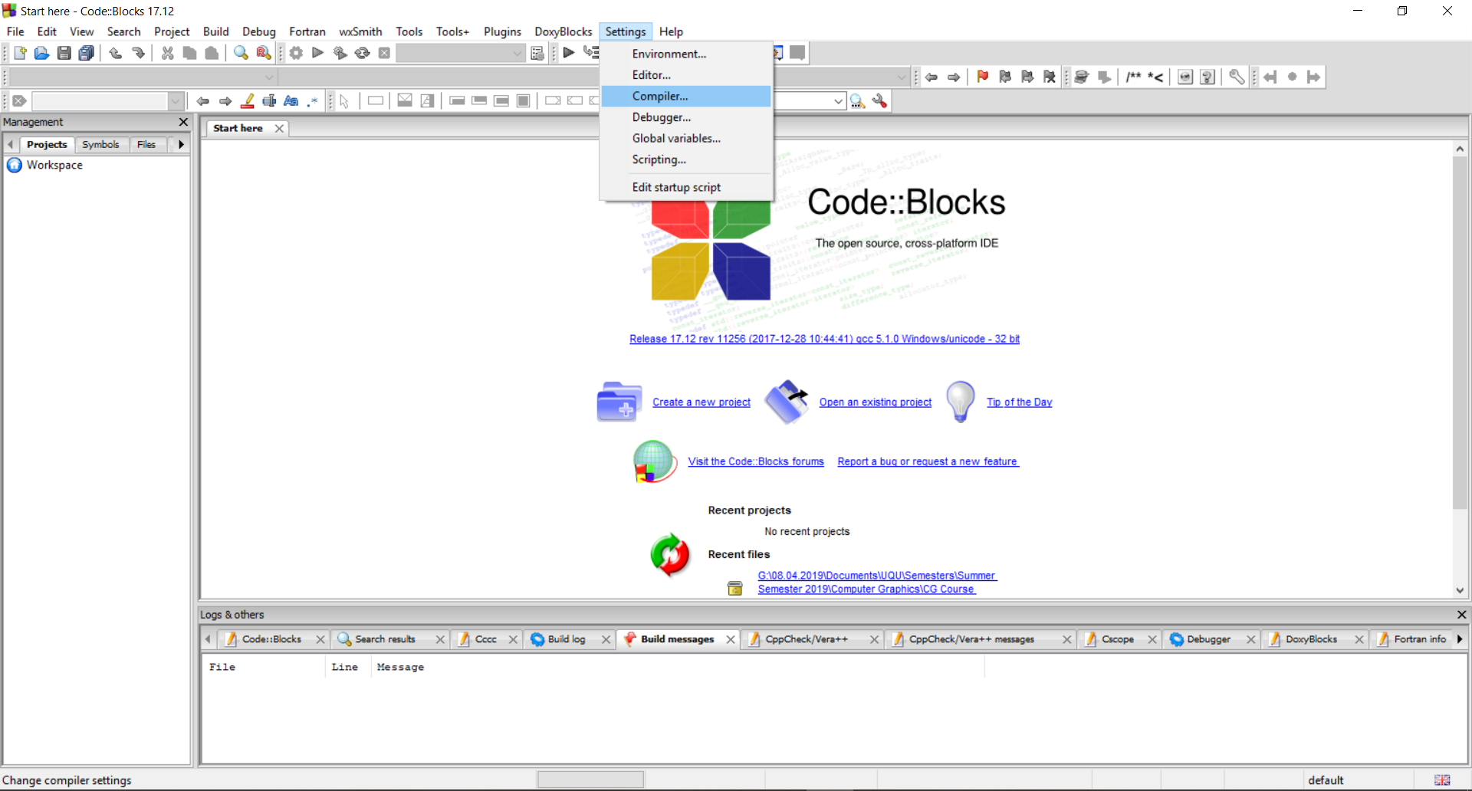
Setting-Up the Environment

Slide 23
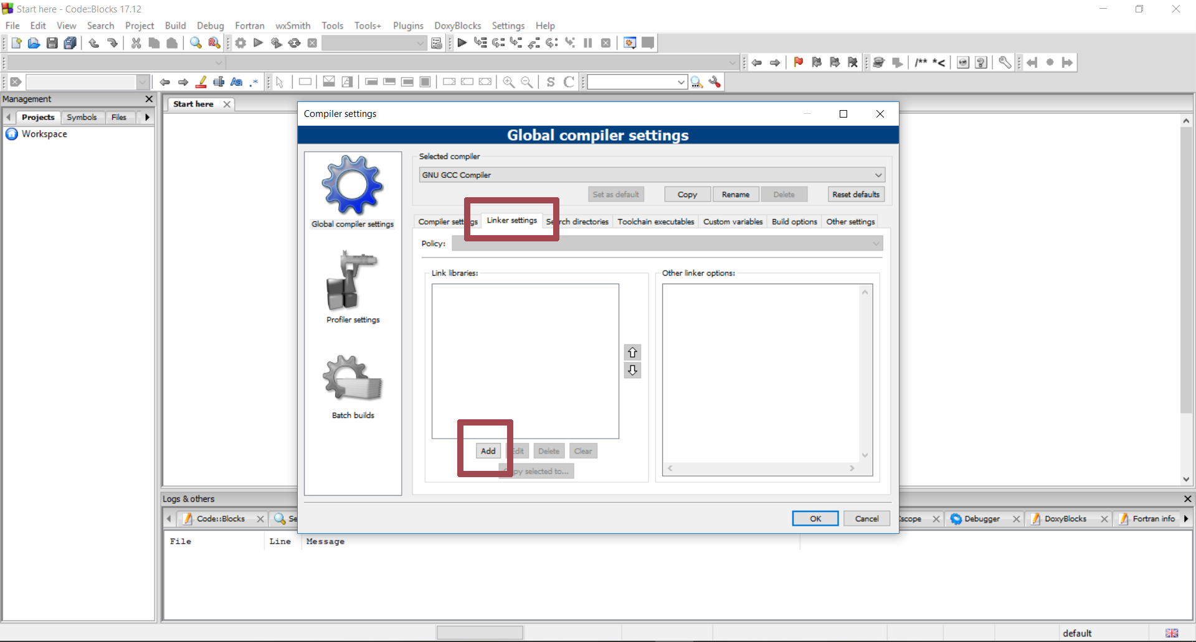
Setting-Up the Environment

Slide 24
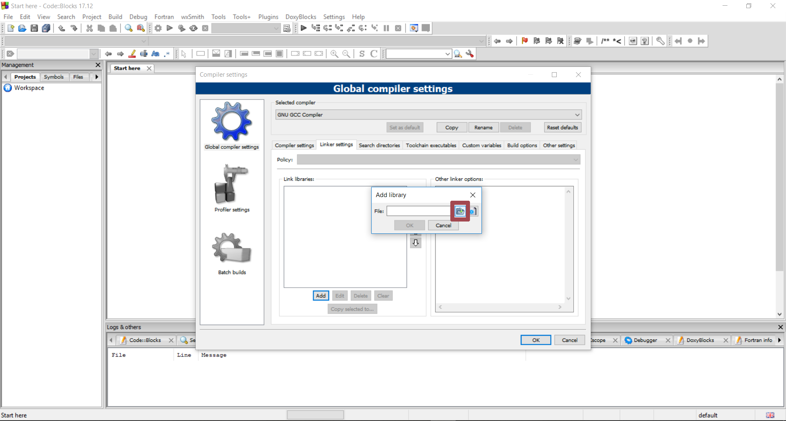
Setting-Up the Environment

Slide 25
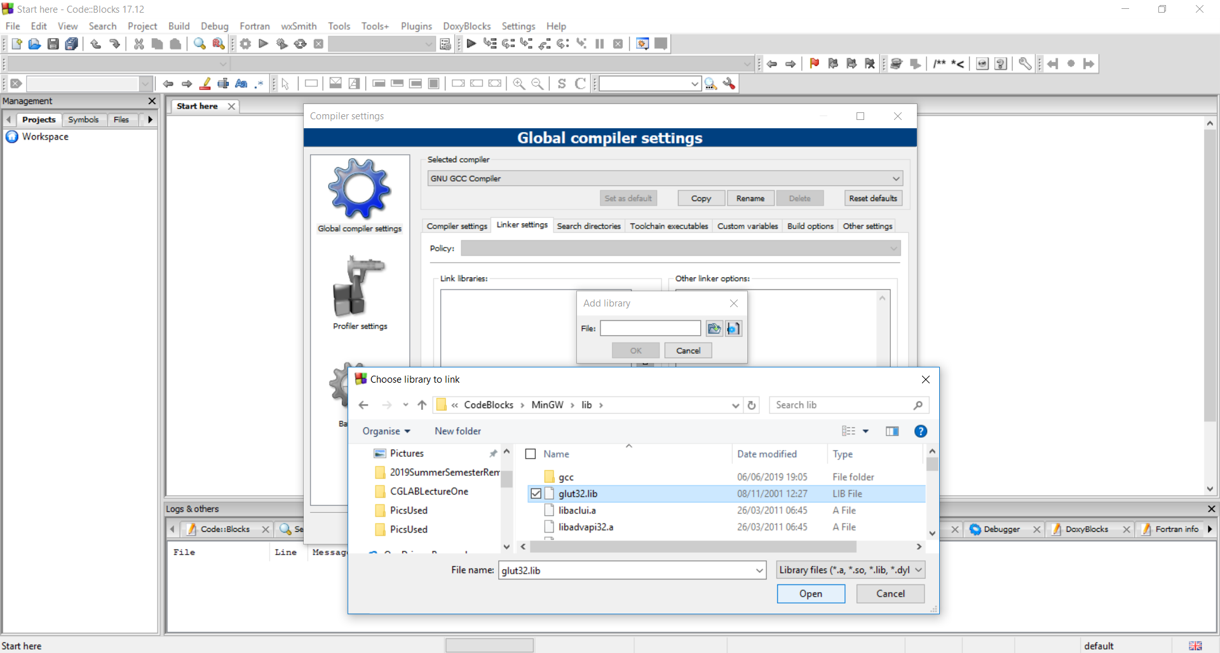
Setting-Up the Environment

Slide 26
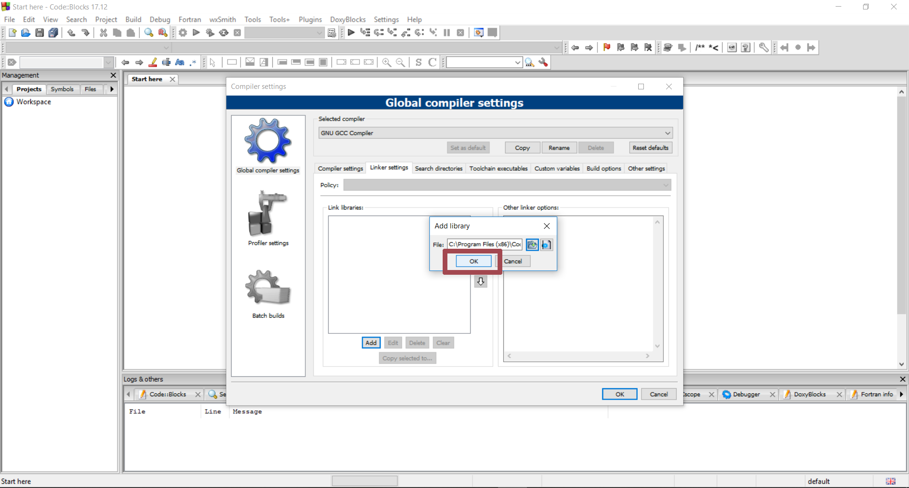
Setting-Up the Environment

Slide 27
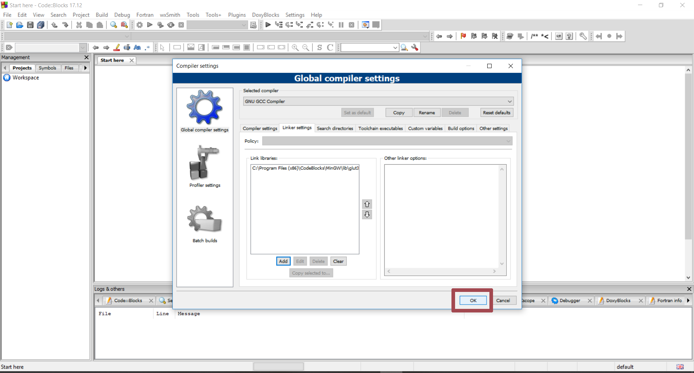
Setting-Up the Environment

Slide 28
Setting-Up the Environment
Now, you are ready to use OpenGL in Code::Blocks.

Slide 29
وصلّى الله وبارك على نبيّنا محمد
The End Summary of Lecture One T.Mariah Khayat الأستاذة/ مارية خياط Adham University College الكلية الجامعية بأضم mskhayat@uqu.edu.sa

