Slide 2
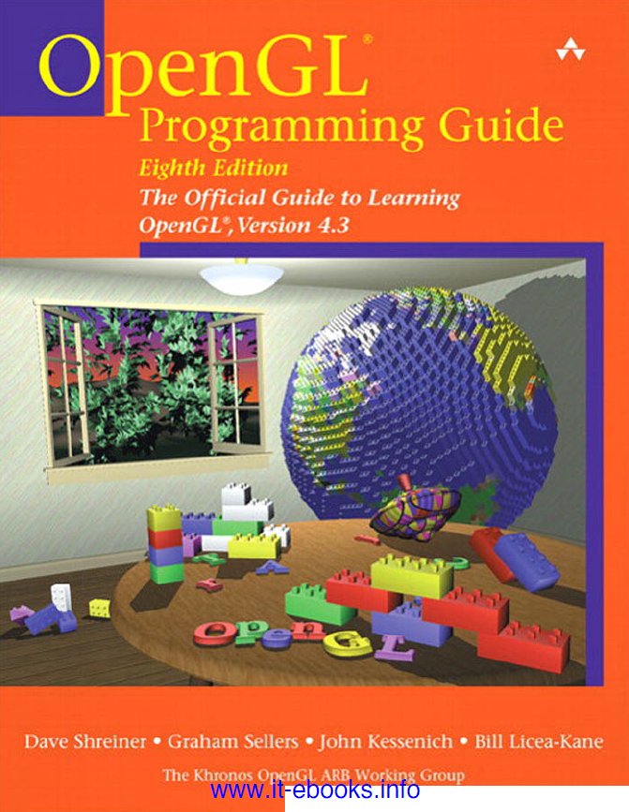
References
Lab Lectures, Computer Graphics, Taif University, Faculty Of Computers And Information Technology, TA. Maha Thafar &TA. Haifa Alshehri, TA.Sohair Soliman & L.Shakila Bano.
OpenGL Programming Guide: The Official Guide to Learning OpenGL, Versions 4.3, 8th edition, Dave Shreiner, Graham Sellers, John Kessenich, Bill Licea-Kane & The Khronos OpenGL ARB Working Group, Addison-Wesley.

Slide 3
Lecture Eleven
Menus in OpenGL

Slide 4
Content
Steps to Create a Menu
Creating a Menu in GLUT
Associating a Menu with a Mouse Key
Adding Entries to the Menu
Building a Sub Menu
Example Program
Create a Sub Menu Program

Slide 5
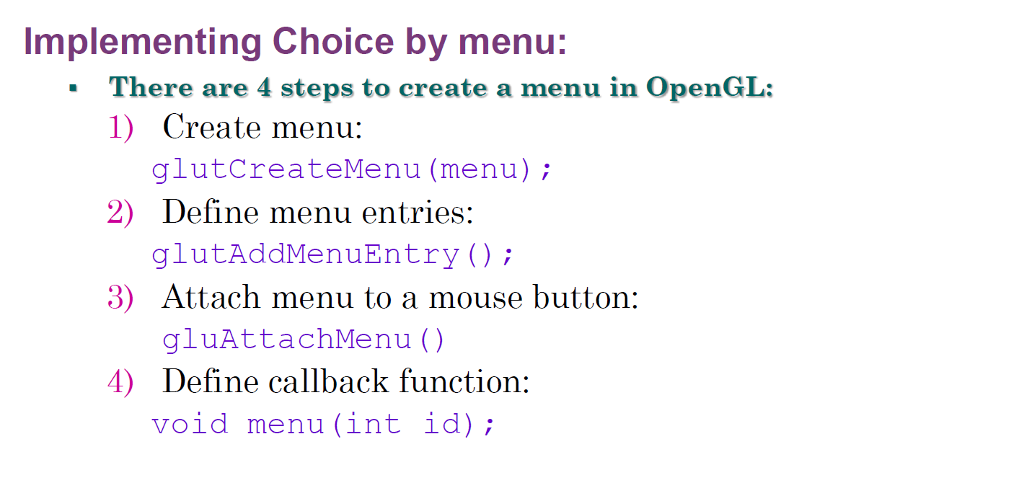
Steps to Create a Menu

Slide 6
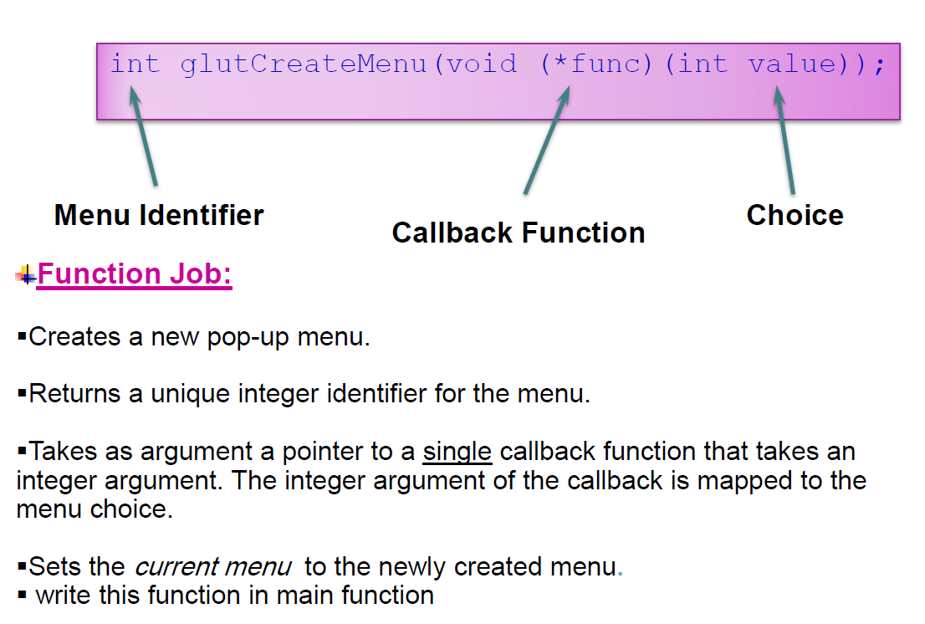
Creating a Menu in GLUT

Slide 7
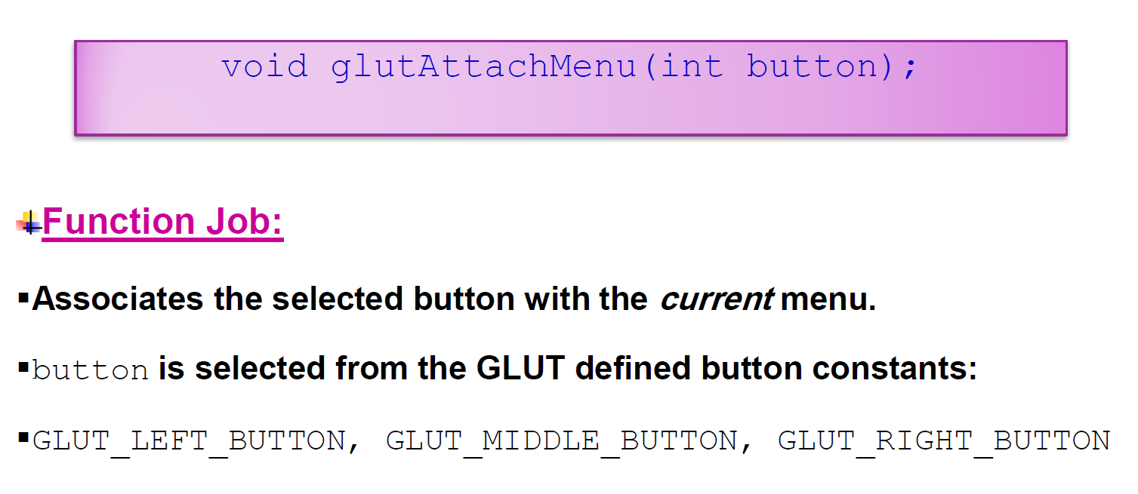
Creating a Menu in GLUT

Slide 8
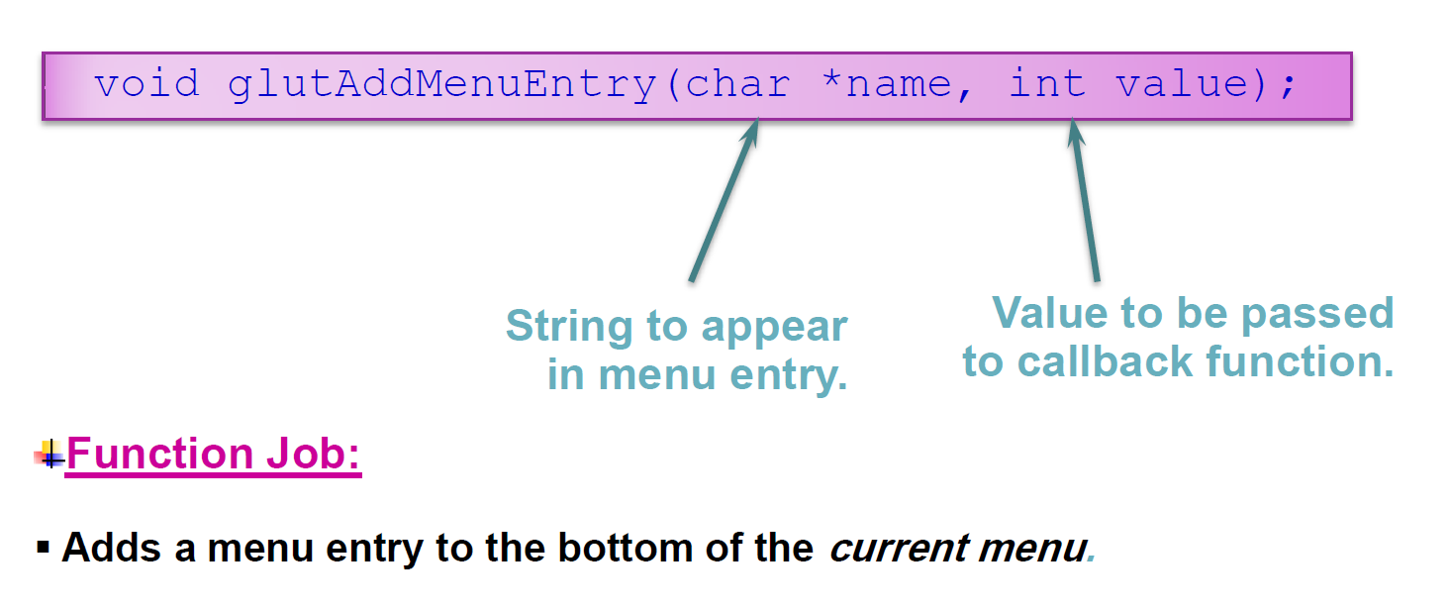
Adding Entries to the Menu

Slide 9
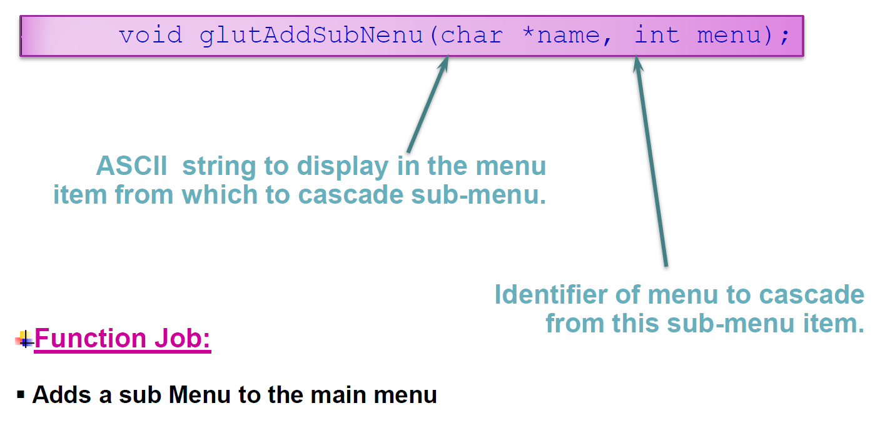
Building a Sub Menu

Slide 10
Example Program
#include<windows.h>
#include<GL/glut.h>
int menu;
static float Size = 2.3, spin = 0.0;
void render() {
glClear(GL_COLOR_BUFFER_BIT | GL_DEPTH_BUFFER_BIT);
glLoadIdentity();
glEnable(GL_DEPTH_TEST); //Lighting Function
glEnable(GL_LIGHTING);
glEnable(GL_LIGHT0);
glEnable(GL_COLOR_MATERIAL);
glColor3f(1.0, 0.6, 0.6);
glTranslatef(-0.7, -2.0, -12); //Drawing the Teapot
glRotatef(spin, 0.0, 1.0, 0.0);
glutSolidTeapot(Size);
glutSwapBuffers(); }
void SpinTeapot() {
spin = spin + 1;
if (spin > 360.0)
spin = spin - 360.0;
glutPostRedisplay(); }
void reshape(int w, int h) {
glViewport(0, 0, w, h);
glMatrixMode(GL_PROJECTION);
glLoadIdentity();
gluPerspective(45.0, (float)w/(float)h, 1.0, 1000.0);
glMatrixMode(GL_MODELVIEW);
glLoadIdentity(); }
void MenuEvents(int click) { //Functions Dealing With Menu Events
switch(click) {
case 10: glutIdleFunc(SpinTeapot); break;
case 20: glutIdleFunc(NULL); break;
case 30: Size-=0.5; break;
case 40: Size+=0.5; break;
}
glutPostRedisplay(); }

Slide 11
Example Program
void init() {
glClearColor(1.0, 1.0, 1.0, 0.0); }
int main() {
glutInitDisplayMode(GLUT_DEPTH | GLUT_DOUBLE | GLUT_RGB);
glutInitWindowPosition(100, 100);
glutInitWindowSize(400, 400);
glutCreateWindow("Create a Menu!");
init();
glutDisplayFunc(render);
glutReshapeFunc(reshape);
menu = glutCreateMenu(MenuEvents);//Creating a Menu
glutAddMenuEntry("Rotation", 10); //Adding Menu Items
glutAddMenuEntry("Stop Rotation", 20);
glutAddMenuEntry("Zoom Out", 30);
glutAddMenuEntry("Zoom In", 40);
glutAttachMenu(GLUT_RIGHT_BUTTON);
glutMainLoop();
return 0;}

Slide 12
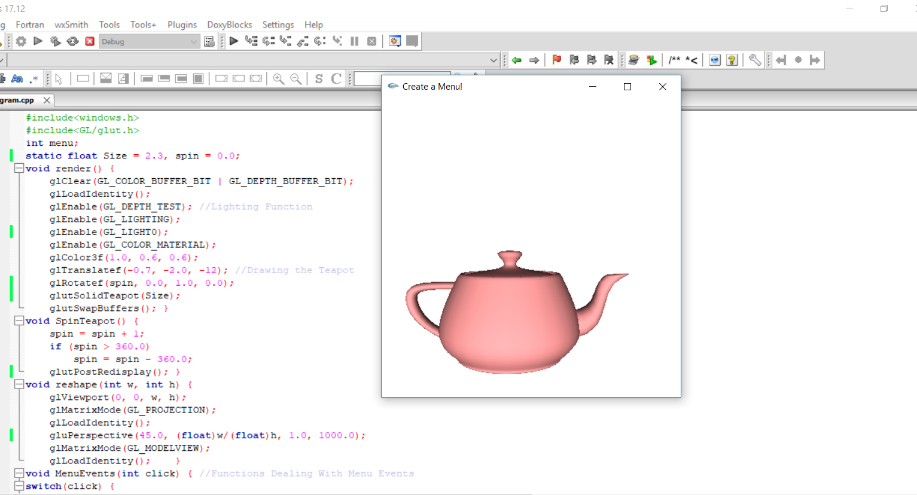
Example Program

Slide 13
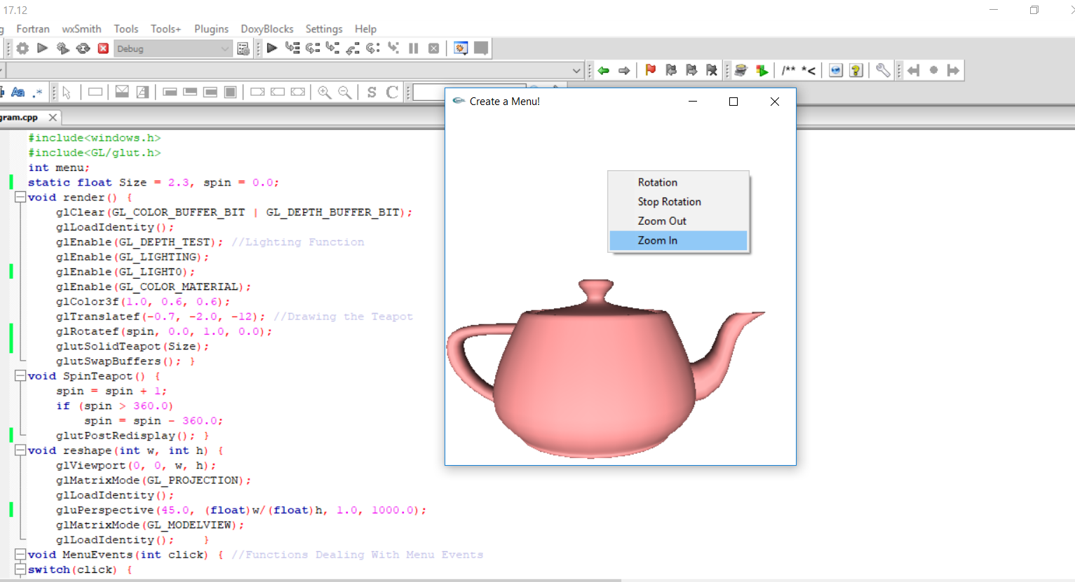
Example Program

Slide 14
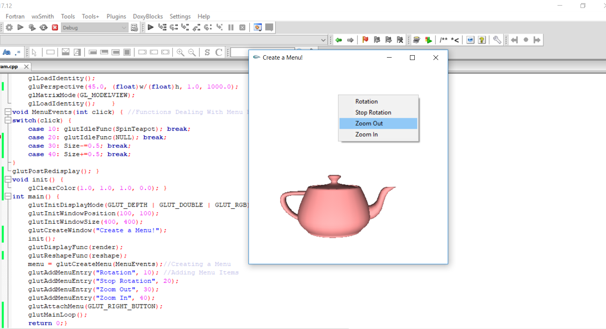
Example Program

Slide 15
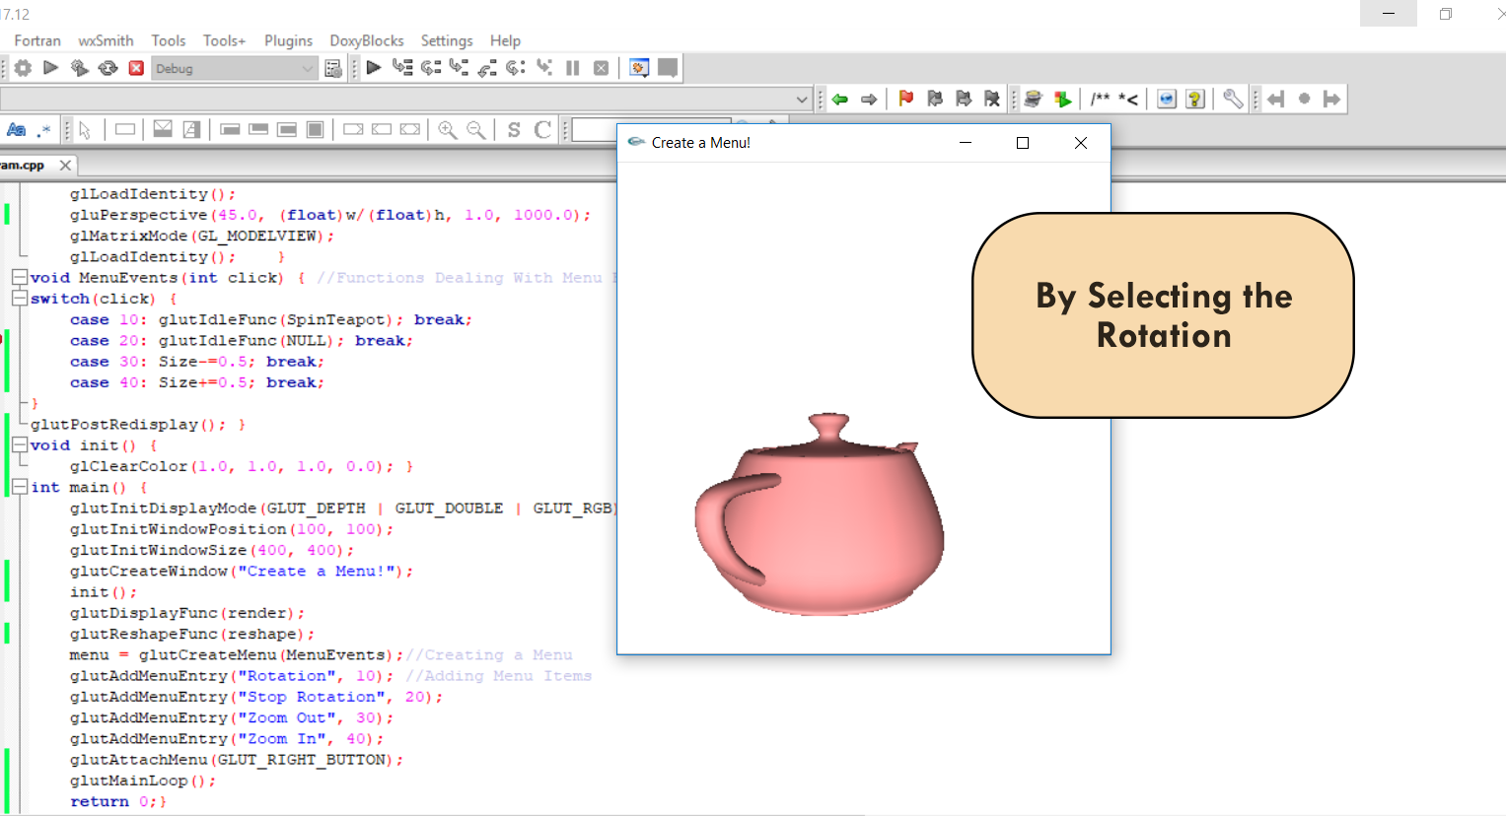
Example Program

Slide 16
Create a Sub-Menu Program
#include<windows.h>
#include<GL/glut.h>
float R = 141, G = 94, B = 59;
void render(void) {
glClear(GL_COLOR_BUFFER_BIT | GL_DEPTH_BUFFER_BIT);
glLoadIdentity();
glPushMatrix();
glEnable(GL_DEPTH_TEST); //Lighting Functions
glEnable(GL_LIGHTING);
glEnable(GL_LIGHT0);
glEnable(GL_COLOR_MATERIAL);
glColor3ub(R, G, B);
glTranslatef(-4.7, -5.0, -12); //Draw the Torus
glRotatef(-44, 1, 1, 1);
glutSolidTorus(5.4, 9, 50, 50);
glDisable(GL_DEPTH_TEST); //Disabling the light
glDisable(GL_LIGHTING);
glPopMatrix();
glPushMatrix(); //Drawing the white dots
glPointSize(3);
glColor3f(1,1,1);
glBegin(GL_POINTS);
glVertex2f(-10,-2); glVertex2f(-7,0);
glVertex2f(-13,-5); glVertex2f(-10.5,-6);
glVertex2f(-12,-2); glVertex2f(-10,2);
glVertex2f(-12,-4); glVertex2f(-12,-8);
glVertex2f(-6,-10); glVertex2f(-10,-11);
glVertex2f(-9,3); glVertex2f(-7,1);
glVertex2f(-6,3); glVertex2f(-4,1);
glVertex2f(-2,3); glVertex2f(1,1);
glVertex2f(0,3); glVertex2f(3,1);
glVertex2f(0,-7); glVertex2f(2,-3);
glVertex2f(0,-9); glVertex2f(-3,-12);
glVertex2f(2,-5); glVertex2f(4,-3);
glVertex2f(-3,-9); glVertex2f(-8,-11);
glVertex2f(0,3); glVertex2f(3,1);
glVertex2f(0,3); glVertex2f(3,1);
glVertex2f(-10,-9); glVertex2f(-9,-10);
glEnd();
glPopMatrix();
glutSwapBuffers();
}

Slide 17
Create a Sub-Menu Program
void reshape(int w, int h) {
glViewport(0, 0, w, h);
glMatrixMode(GL_PROJECTION);
glLoadIdentity();
glOrtho(-20.0, 20.0, -20.0, 25.0, -20.0, 20.0);
glMatrixMode(GL_MODELVIEW);
glLoadIdentity(); }
void RedSubMenu(int click) {
switch (click) {
case 1: R = 116, G = 0, B = 0; break;
case 2: R = 222, G = 0, B = 0; break;
case 3: R = 255, G = 113, B = 113; break;
case 4: R = 255, G = 133, B = 194; break;
} glutPostRedisplay();}
void ColorSubMenu(int click) {
switch (click) {
case 1: R = 45, G = 135, B = 90; break;
case 2: R = 0, G = 153, B = 255; break; }
glutPostRedisplay();
}
void MenuEvents(int click) {
switch (click) {
case 1: exit(0); break;
}
}
void CreateSubMenu() {
int SubMenu1, SubMenu2;
SubMenu2 = glutCreateMenu(RedSubMenu);//Create the third sub-menu:
glutAddMenuEntry("Dark Red", 1);
glutAddMenuEntry("Red", 2);
glutAddMenuEntry("Faith Red", 3);
glutAddMenuEntry("Pink Red", 4);
SubMenu1 = glutCreateMenu(ColorSubMenu); //Create the second sub-menu:
glutAddSubMenu("Degrees of Red", SubMenu2);
glutAddMenuEntry("Green", 1);
glutAddMenuEntry("Blue", 2);
glutCreateMenu(MenuEvents); //Create Main menu
glutAddSubMenu("Color", SubMenu1);
glutAddMenuEntry("Exit", 1);
glutAttachMenu(GLUT_LEFT_BUTTON);
}

Slide 18
Create a Sub-Menu Program
int main() {
glutInitDisplayMode(GLUT_DEPTH | GLUT_DOUBLE | GLUT_RGBA);
glutInitWindowPosition(100, 100);
glutInitWindowSize(800, 800);
glutCreateWindow("Menus");
glutDisplayFunc(render);
glutReshapeFunc(reshape);
CreateSubMenu();
glutMainLoop();
return 0;
}

Slide 19
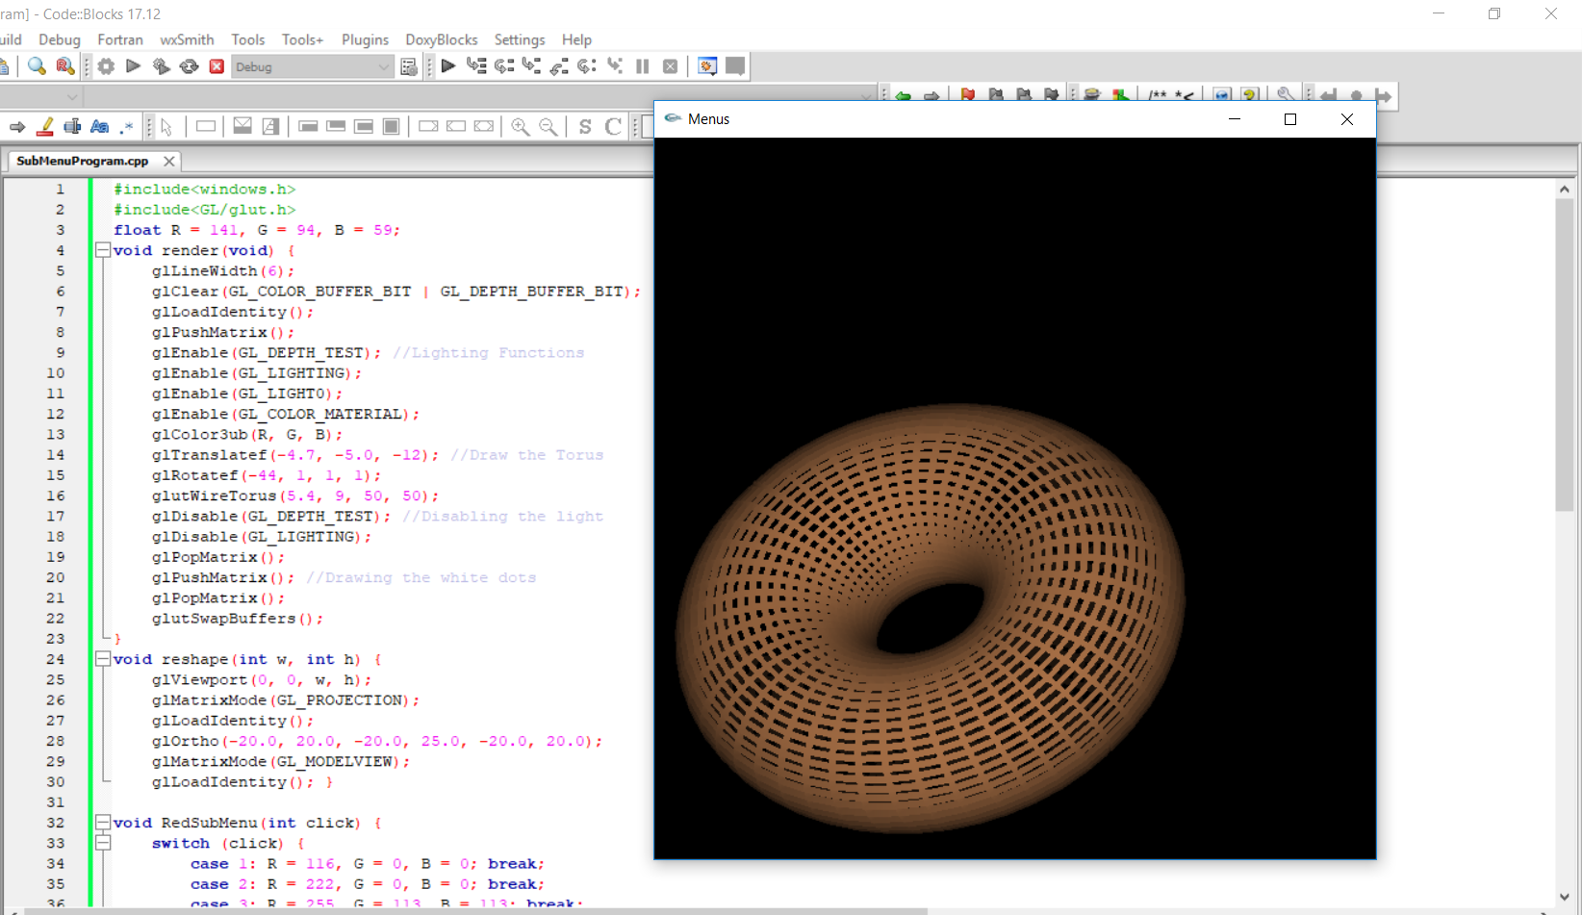
Create a Sub-Menu Program

Slide 20
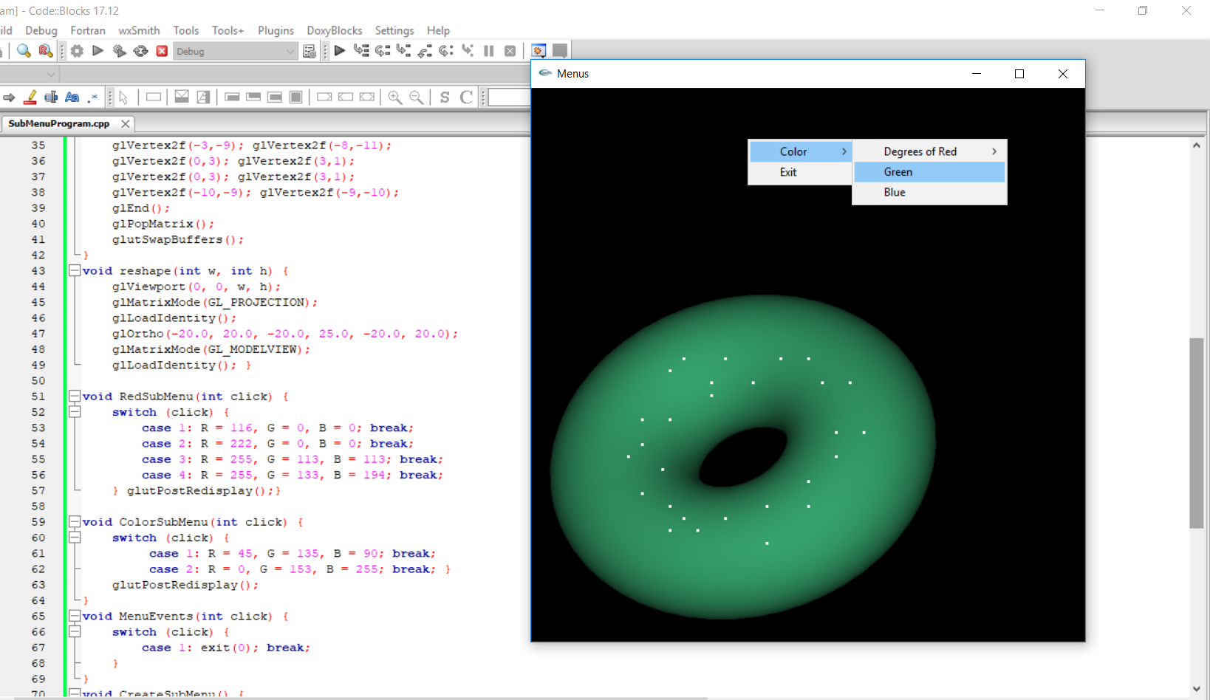
Create a Sub-Menu Program

Slide 21
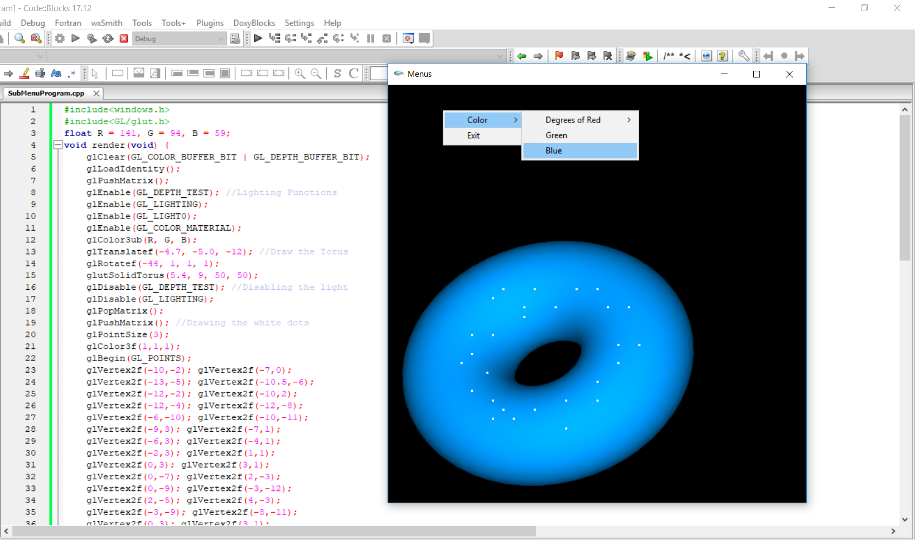
Create a Sub-Menu Program

Slide 22
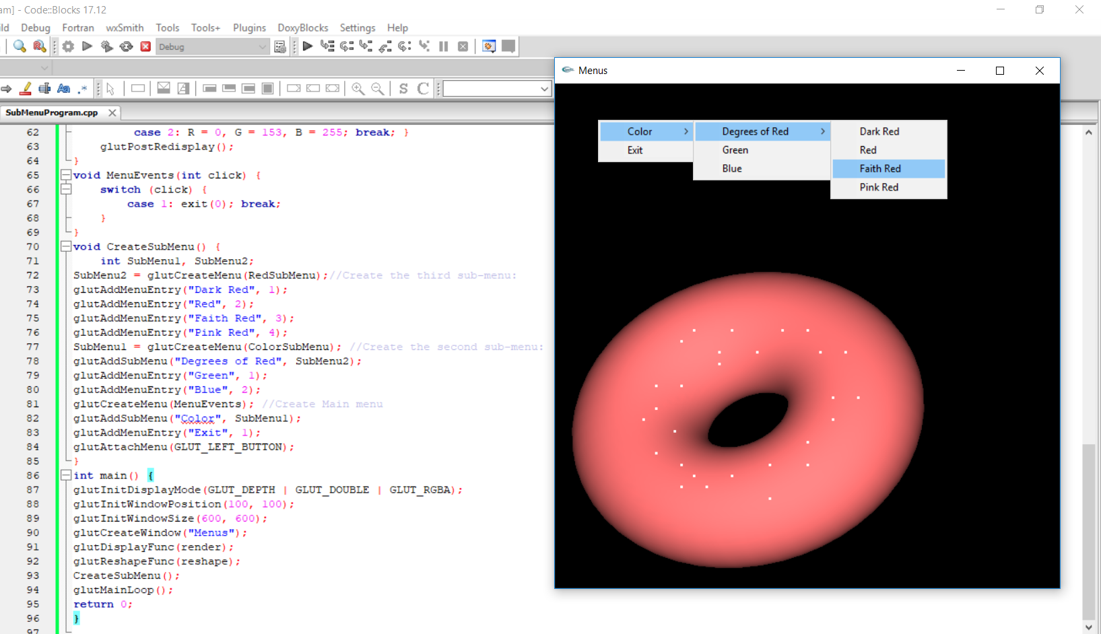
Create a Sub-Menu Program

Slide 23
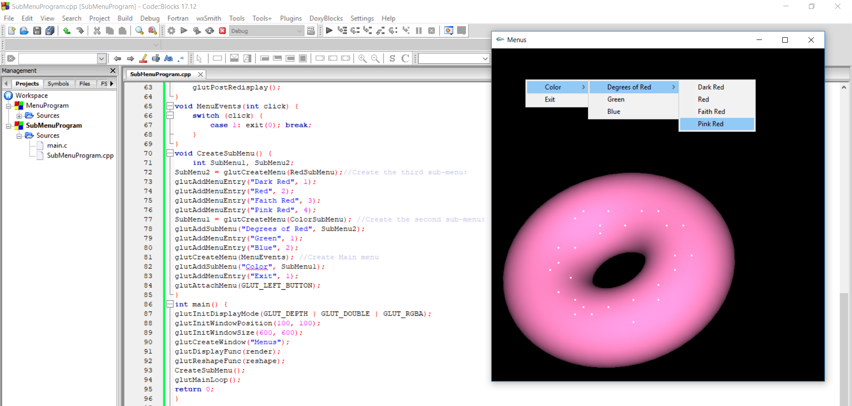
Create a Sub-Menu Program

Slide 24
وصلّى الله وبارك على نبيّنا محمد
The End Summary of Lecture Eleven
T.Mariah Khayat
الأستاذة/ مارية خياط
Adham University College
الكلية الجامعية بأضم
mskhayat@uqu.edu.sa

