Slide 1

Dr. Nasser A. Elhawary
Prof. of Molecular Genetics
Faculty of Medicine, UQU
Hormonal Regulation of Gene Expression
Year 3
Module B

Slide 2
Session Outcomes
Understand gene expression process
Understand how gene expression is regulated
Differentiate between different gene types and how they are regulated
Classify hormone types
Explain how different hormone types regulate gene expression

Slide 3


Gene expression
Gene Expression. a process by which information from a gene is used in the synthesis of a functional gene product.
These products are often proteins, but in non-protein coding genes such as transfer RNA (tRNA) or small nuclear RNA genes, the product is a functional RNA.
Steps in the gene expression process: 1) transcription, 2) post-transcriptional modification, 3) translation, and 4) post-translational modification of a protein.
Transcription process
Post-transcriptional process

Slide 4
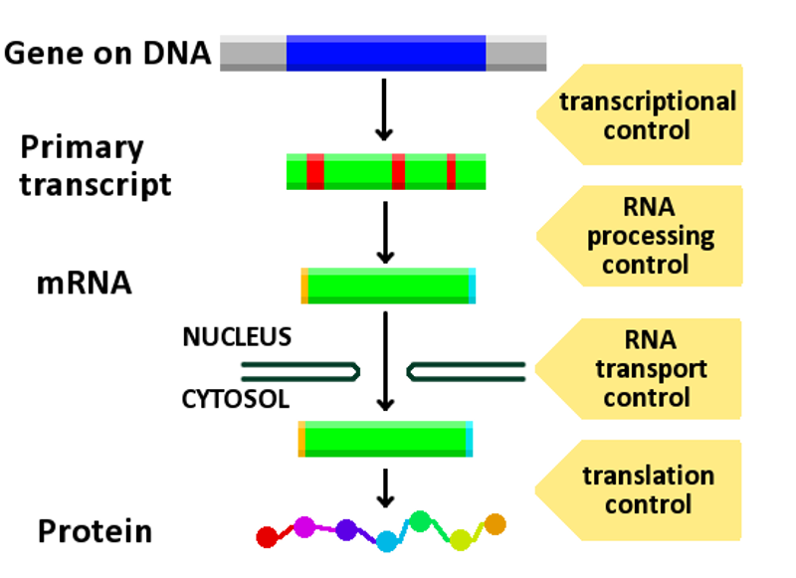
Gene expression

Slide 5
Regulation of gene expression
Regulation of gene expression refers to the control of the amount and timing of appearance of the functional product of a gene.
It includes a wide range of mechanisms that are used by cells to increase or decrease the production of specific gene products (protein or RNA), and is informally termed gene regulation
It includes response to environmental stimuli, or adaptation to new food sources

Slide 6
Regulation of gene expression
Often, one gene regulator controls another.
Gene regulation gives the cell control over all structure and function, and is the basis for cellular differentiation, morphogenesis and the versatility and adaptability of any organism.

Slide 7
Regulation of gene expression
Gene expression can be either up-regulated or down regulated
Up-regulation is a process that occurs within a cell triggered by a signal, which results in increased expression of one or more genes.
Down-regulation is a process resulting in decreased gene and corresponding protein expression.

Slide 8
Types of genes and how they are regulated
A constitutive gene (e.g., COX-1 in stomach) is a gene that is transcribed continually as opposed to a facultative gene, which is only transcribed when needed.
A housekeeping gene is a gene that is required to maintain basic cellular function and so is typically expressed in all cell types of an organism; e.g., actin, GAPDH, ubiquitin, RNA polymerases, etc.
A facultative gene is a gene only transcribed when needed as opposed to a constitutive gene.
An inducible gene (e.g., COX-2, produce prostaglandin ‘vasodilators’) is a gene whose expression is either responsive to environmental change or dependent on the position in the cell cycle.

Slide 9
Hormones
Hormones are molecules that are produced in one cellular location in an organism, and whose effects are seen in another tissue or cell type.
In mammals, hormones can be proteins or steroids.
The protein hormones do not enter the cell, but bind to receptors in the cell membrane and mediate gene expression through intermediate molecules.
Steroid hormones, though actually enter the cell and interact with steroid receptor proteins to control gene expression (corticosteroids & sex steroids).
Androgen, estrogen, progestogen
Glucosteroid & mineralocorticoid

Slide 10
Protein (peptide) hormone
To regulate gene expression, a peptide hormone has to have a receptor in the target cell.
When a peptide hormone binds to its receptor, signal transduction occurs, and substances called second messengers are released to activate specific proteins in order to increase or inhibit the production of certain gene products.
The main second messengers include calcium, cyclic adenosine monophosphate (cAMP), inositol triphosphate, and diacylglycerol (DAG).

Slide 11
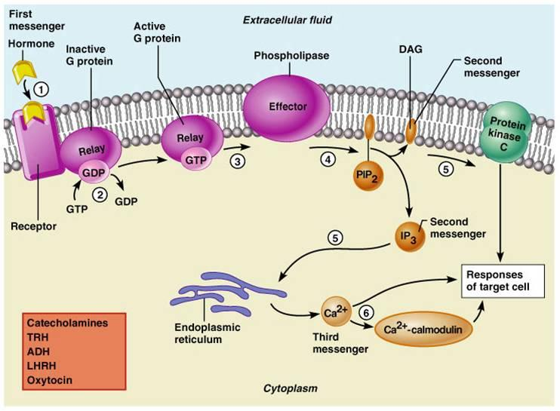
Protein hormone

Slide 12
Steroid hormones
Steroid hormones can be grouped into five groups by the receptors to which they bind: glucocorticoids, and mineralo-corticoids (corticosteroid) & androgens, estrogens, and progestogens (sex steroids).
Steroid hormone enter the cell and interacts with intra-cellular receptor.
Hormone receptor complex then enter the nucleus and regulate gene expression.

Slide 13
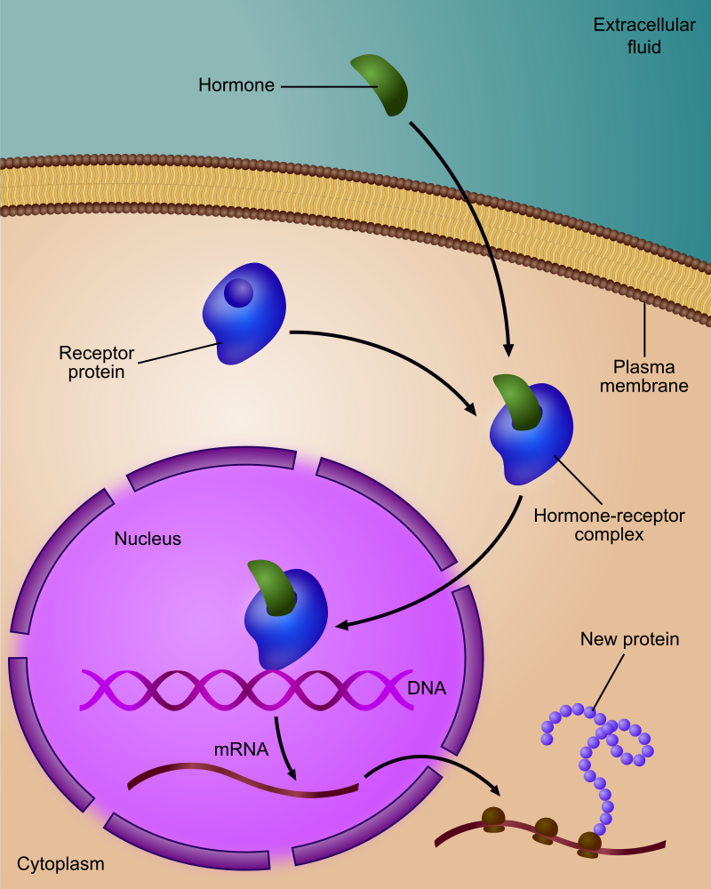
Steroid hormones
Hormone receptors can behave as transcription factors by interacting directly with DNA. Shortage of nuclear receptor binding can have drastic effects on gene expression and on the cell. For example, estrogen deficiency is a cause of osteoporosis and the inability to undergo a proper signaling, prevents bone growth and strengthening.

Slide 14
Steroid hormones regulation of gene expression
A number of steroid-receptor proteins have been characterized, and a number of features are common among them.
The N-terminal region of the protein is required to activate transcription. This is the least conserved region among the eight proteins.
The central portion of the protein is required for DNA binding, and this region is highly conserved (42-94% amino acid identity).
The C-terminal region is required for steroid binding and is moderately conserved (15-52% amino acid identity). This overall conservation suggests that an ancestral gene may have been the model for each of these genes.

Slide 15
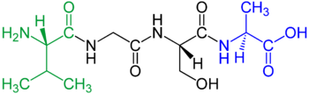
An example showing N-terminal (amino-) & C-terminal (carboxy-) & the central region of the protein moiety
Val-Gly-Ser-Ala

Slide 16
Example of hormonal regulation of gene expression
Glucocorticoid is one type of steroid that interacts with a receptor protein.
If Hsp90 is bound to the receptor, gene expression is inactive.
However, binding of Glucocorticoid to receptor protein stimulates the release of the Hsp90 that is bound to the receptor protein.
The receptor protein then forms a dimer. This complex then binds to the enhancer sequences (of DNA) and gene expression is then activated.
Hsp90 (Heat shock protein): is a chaperone protein that assists other proteins to fold properly, stabilizes proteins against heat stress, and aids in protein degradation. It also stabilizes a number of proteins required for tumor growth, which is why Hsp90 inhibitors are investigated as anti-cancer drugs.
https://www.ncbi.nlm.nih.gov/pmc/articles/PMC4087167/pdf/nihms600453.pdf

Slide 17
Example (2) of hormonal regulation of gene expression
Regucalcin (rgn gene; OMIM #300212; Xp11.23) is a calcium-binding protein, that is preferentially expressed in the liver and kidney. It may have an important role in calcium homeostasis. .
Regucalcin mRNA expression has been shown to be regulated by hormonal factors (e.g., parathyroid hormone, insulin, TNF-α, estrogen, testosterone, aldosterone, etc.) in various tissues and many cell types.

